Slide 1
Decision Making
Simply a decision is an act of selection or choice of one action from several alternatives.
Decision-making can be defined as the process of selecting a right and effective course of action from two or more alternatives for the purpose of achieving a desired result. Decision-making is the essence of management.
According to P. F. Drucker – “What­ever a manager does he does through making decisions.” All matters relating to planning, organising, direction, co-ordination and control are settled by the managers through decisions which are executed into practice by the operators of the enterprise. Objectives, goals, strate­gies, policies and organisational designs are all to be decided upon in order to regulate the performance of the business.
The entire managerial process is based on decisions. Decisions are needed both for tackling the problems as well as for taking maximum advantages of the opportunities available. Correct decisions reduce complexities, uncertainties and diversities of the organisational environments.

Slide 2
Goal Oriented
Selective
Cognitive
Evaluative
Characteristic of Decision making
Dynamic
Ongoing
Positive or Negative

Slide 3
Goal Oriented
Decision-making is a goal-oriented component of management. During the course of the organization, managers have to make decisions considering the achievement of organizational goals and objectives.
All the decisions made in the organization by the top or lower managers are directed toward the overall goals of the organization. For this, managers are responsible for making the right as well as an effective decision that ensures better goal achievement.
Continuous Process
Decision-making is a continuous process that remains in the organization till it is left. Managers as well as other employees need to make several decisions every day.
From entering the organization (office) to managing different activities and employees, to leaving the office managers have to make many decisions based on time, requirements, and situations.

Slide 4
Selective Process
Decision-making is also selective in nature. It is a process of selecting the best option from the pool of available options. Managers have to select the best alternative that has greater potential to ensure goal achievement after careful evaluation of all alternatives.
Dynamic Process
It is obvious that today’s business environment is dynamic in nature. It is necessary that managers should consider the dynamic and changeable environmental factors while making any decisions.
For the effectiveness of decisions, managers have to make decisions on time. In addition, they should consider the future impact of the decision and how the decision will be affected in the future by possible conditions

Slide 5
Evaluation
Evaluation is a key characteristic of good decision making. This involves considering all of the options and weighing their pros and cons before making a choice. It is important to be as objective as possible when evaluating the different options, and to look at the situation from all angles.
Cognitive: As the decision making encompasses the application of intellectual abilities, such as analysis, knowledge, experience, awareness and forecasting, it is a cognitive process.
Positive or Negative: A decision is not always positive, sometimes even after analysing all the points a decision may turn out as a negative one.
Ongoing process: We all know that a company has perpetual succession and various decisions are taken daily by different levels of management to keep the firm going. These decisions are taken, keeping in mind the objectives of the organization.

Slide 6
Types Of Decision Making
Decision by Structure
Programmed Decision
Non-Programmed Decision
Decision by Importance
Major Decision
Minor Decision
Types Of Decisions Making
Decision by Nature
Routine Decision
Basic Strategic Decision
Decision by Complexity
Simple Decision
Complex Decision
Decision by People
Individual Decision
Group Decision

Slide 7
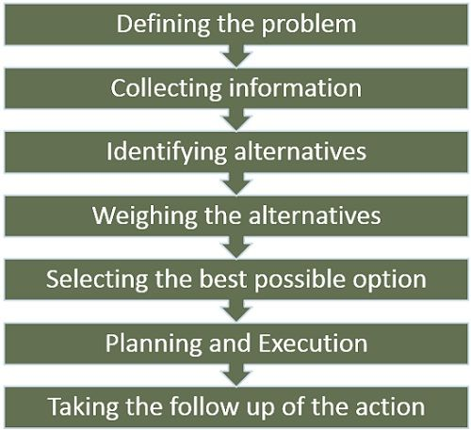
Process Of Decision Making

Slide 8
Approaches to Decision Making
Decision making is a crucial aspect of both personal and professional life. Various approaches can be employed to make decisions, depending on the context, complexity, and the individuals involved. The choice of approach often depends on the nature of the decision, the available information, time constraints, and the preferences of the decision-makers involved. Effective decision making often combines elements from multiple approaches to achieve well-rounded and informed choices

Slide 9
Rational Decision Making
This method involves a systematic analysis of all available data, options, and potential outcomes. It's a logical approach that aims to make the most informed choice based on facts and figures.
Pros: Systematic, logical, and data-driven. Tends to yield well-informed decisions.
Cons: Can be time-consuming, might not account for emotional factors.
Intuitive Decision Making
Our instincts and gut feelings can guide us. Intuitive decision making relies on our inner sense and past experiences to quickly assess situations and make swift choices.
Pros: Quick and relies on past experiences and instincts. Suitable for fast-paced environments.
Cons: Can be influenced by biases and might not consider all relevant information.
Group Decision Making
Collaborative environments benefit from the collective wisdom of team members. Group decision making involves discussions, brainstorming, and considering diverse viewpoints to reach a consensus.
Pros: Incorporates diverse viewpoints, encourages collaboration, and often leads to better decisions.
Cons: Can be time-consuming, might lead to conflicts or difficulties in reaching consensus.

Slide 10
Autocratic Decision Making
In situations where a leader or authority figure holds the decision-making power, this approach comes into play. It's efficient for quick decisions but might not always consider various perspectives.
Pros: Efficient for quick decisions, works well in emergencies or when a clear hierarchy is necessary.
Cons: Doesn't consider input from others, can lead to resentment among team members.
Bounded Rationality
Recognizing that decisions are often made within constraints like time and information, this approach seeks satisfactory solutions rather than exhaustive ones.
Pros: Takes into account constraints, seeks satisfactory solutions, and is pragmatic.
Cons: Might not lead to optimal outcomes, can sometimes ignore critical factors.
.

Slide 11
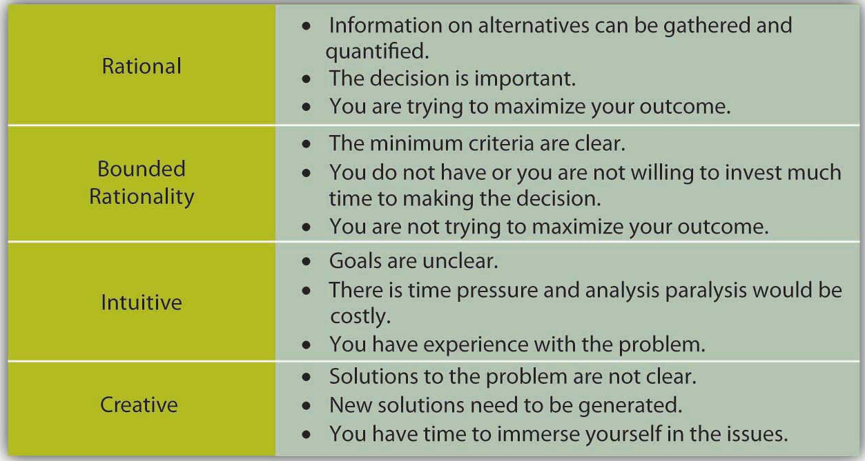

Slide 12
Condition of Decision making
Uncertainty
Uncertainty is a situation where the decision-maker has very little information available about the alternatives. Which is not enough to take an action plan.
The introduction of a new product or service, adoption of new technology, etc.
It creates difficult to understand the environment, predict the future and make a decision.
Certainty
Certainty condition of decision making is a situation where a decision-maker is conformed to what will happen when a decision is being made. It is a condition where the future is 100 percent sure.
This condition exists in routine decisions such as day-to-day activities, payment of wages, salaries.
Risk
In the condition of risk, the decision-maker is aware of alternatives but not of their outcomes or consequences. Here the future condition can not be estimated correctly. It is a condition where the future is sure but less than 100 percent.
Changing the job,

